Slide 1
Social networks on the value chain of companies
By: Cisneros Ruiz Omar Yosafat

Slide 2
Concepts
What is a social network?
What is a value chain?
In which way a social network interacts with a value chain?

Slide 3


Social networks
Social network is a website that brings people together to talk, share ideas and interests or make new friends.

Slide 4

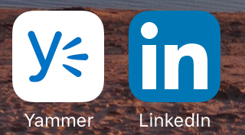
Types of Social Networks
Familiar
Enterprice

Slide 5
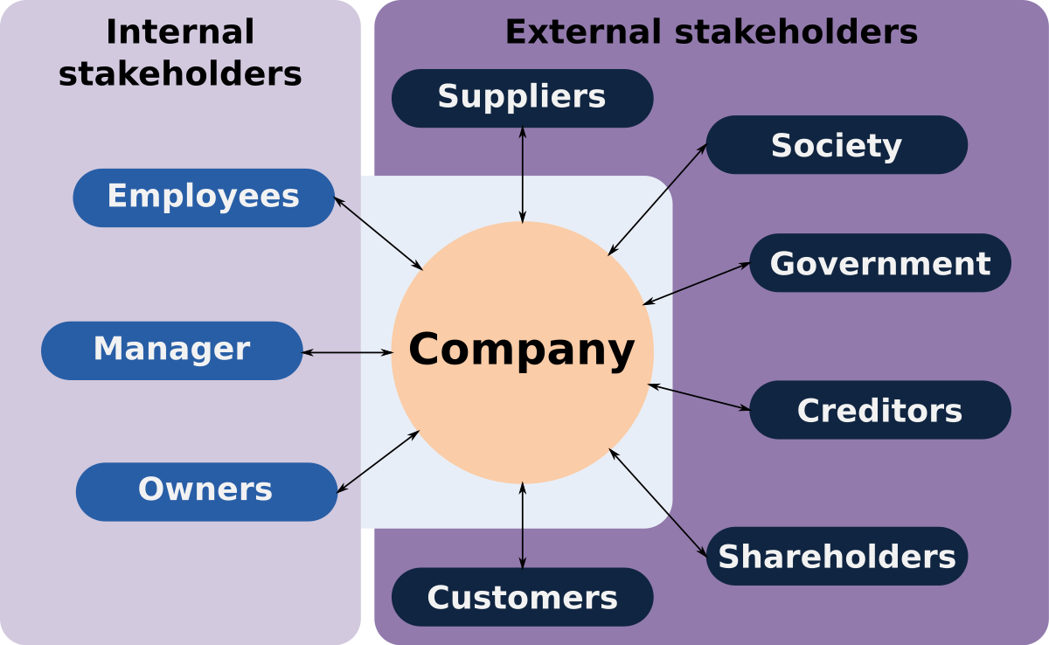
Value

Slide 6
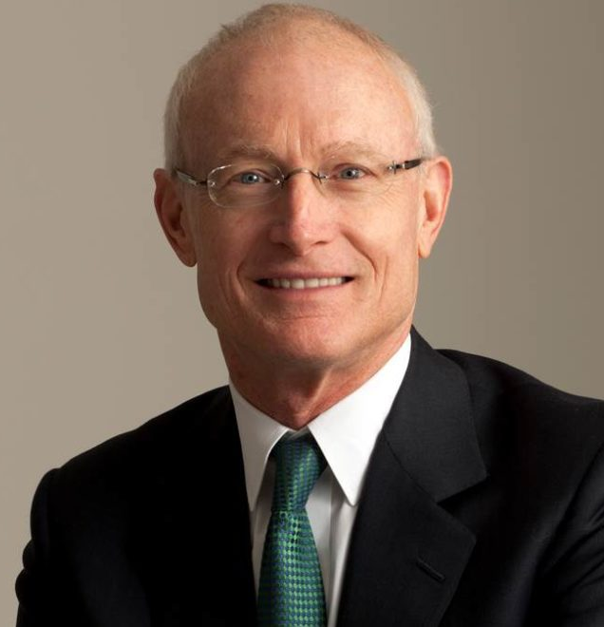
Value chain
The interrelated operating activities businesses perform during the process of converting raw materials into finished products.
Prof. Michael Eugene Porter.

Slide 7
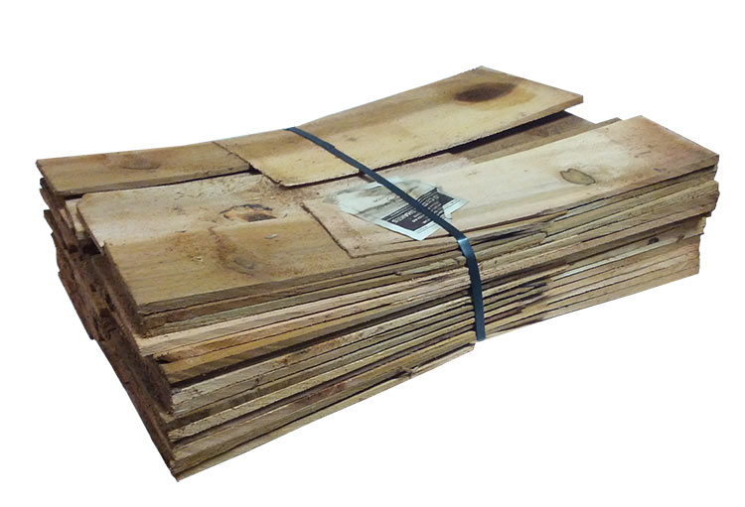
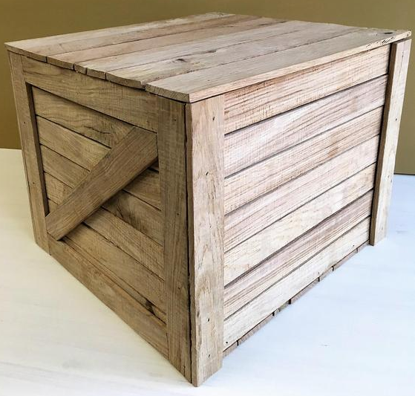
Add value and reduce costs

Slide 8
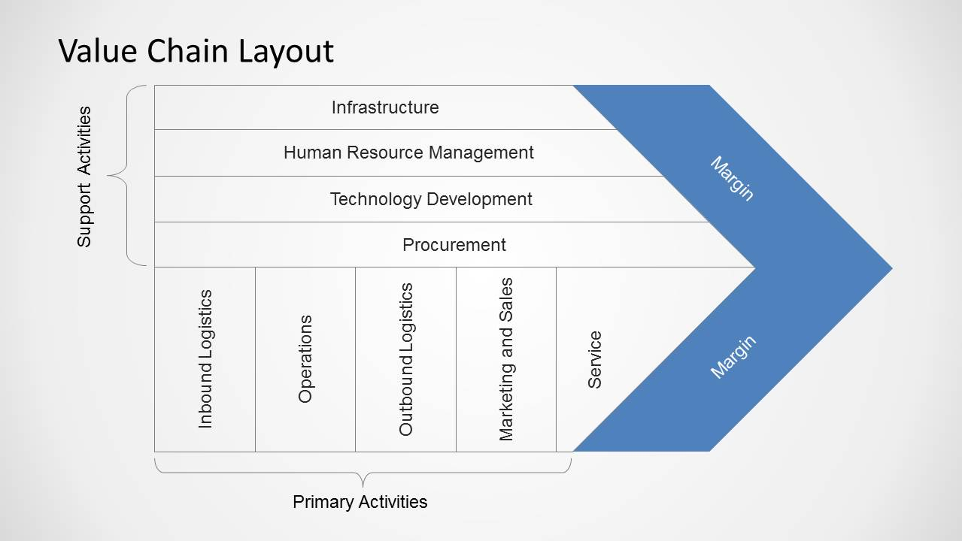

Slide 9

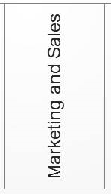
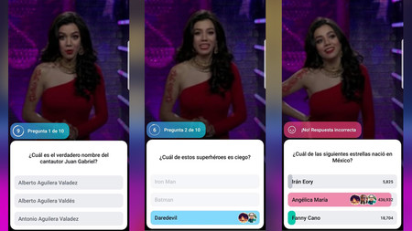
The confetti phenomenon

Slide 10
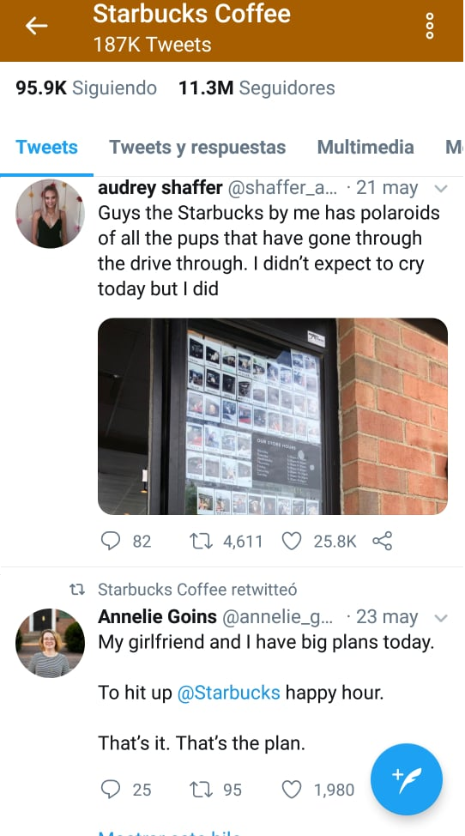
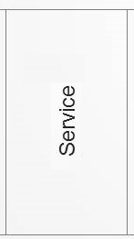
Starbucks

Slide 11
The young people signed up with facebook are the ones who will drive the next two decades of the social web. The data contained in facebook is clean, trustworthy and segmented. This is exactly the kind of data that a marketer would dream of.
(Stutzman, 2006)

